Slide 1
The Role of Variability in Learning Generalization: A Computational Modeling Approach
Thomas Gorman

Slide 2
Introduction
Investigate effects of training variability on learning and generalization
Focus areas: visuomotor skill learning and function learning tasks

Slide 3
Background and Motivation
Importance of training variability
Research gaps in visuomotor skill learning
Previous research in category learning, language learning, and function learning

Slide 4
Common Empirical Patterns

Slide 5
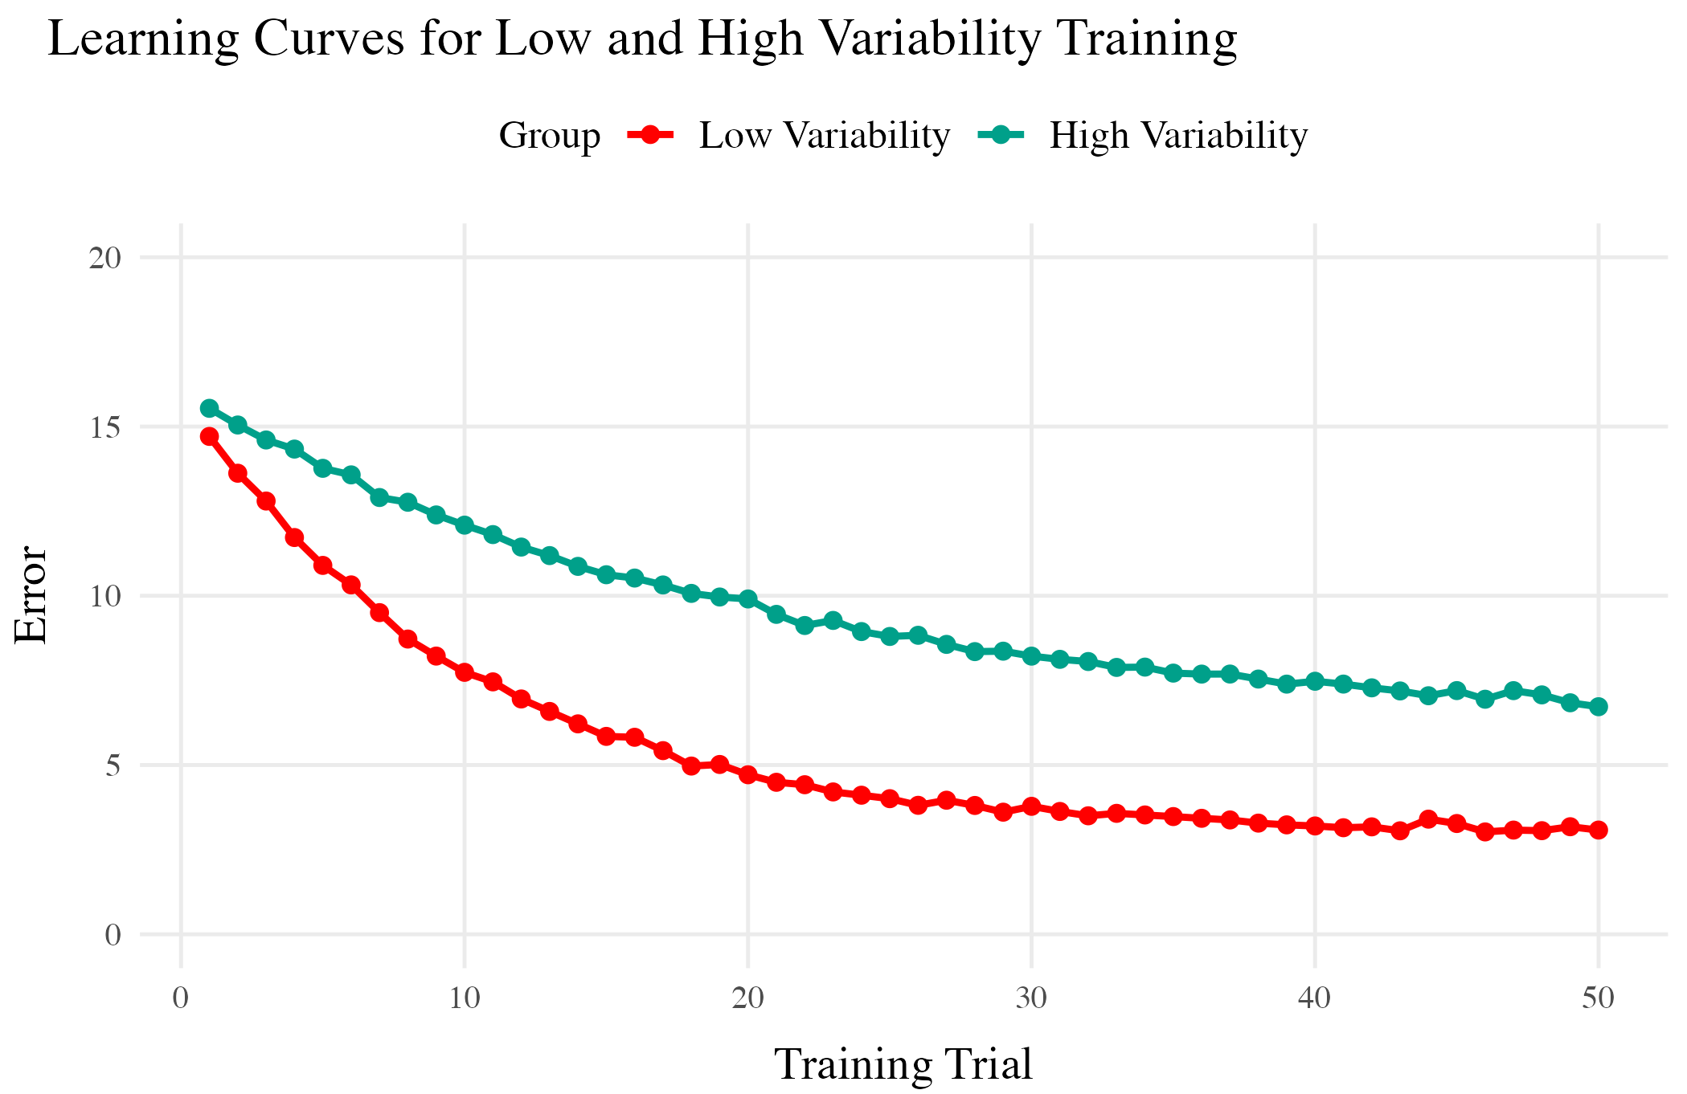
Training
Both training conditions complete the same number of training trials.
Varied group has worse training performance.
Testing
Tested from novel conditions.
Varied group has better test performance

Slide 6
But also plenty of contradictory results and complications
Cases where varied training makes no difference
Cases where more training variation results in worse outcomes
Cases where the influence of variation interacts with some other factor
difficulty
prior knowledge
Frequency effects, or amount of training/learning before testing

Slide 7
Theoretical Frameworks
Schema Theory (Schmidt, 1975)
Desirable Difficulties Framework (Bjork & Bjork, 2011)
Challenge Point Framework (Guadagnoli & Lee, 2004)

Slide 8
Overview of Current Work
Project 1: Visuomotor projectile launching task
Project 2: Visuomotor extrapolation task

Slide 9
Project 1
Influence of varied practice in a projectile launching task
Experiments 1 & 2:
Constant vs. varied training groups
Performance metrics and transfer testing

Slide 10
Hit The Target Task
Training Stage - 200 training trials. Constant groups throws from single position. Varied group 60 trials from 2 locations.
Transfer Stage - All subjects tested from both positions they were trained, and the positions trained by other group
Data recorded - For every throw, recorded the X velocity and Y velocity of ball at release

Slide 11
Project 1 - Manipulations

Slide 12
Experiment 1
Train a varied group from 2 positions, and a constant group from 1. Then test both groups, from the training positions and a novel position.
Experiment 2
6 constant conditions, each trained from a unique location, and a varied condition trained from 2 locations

Slide 13
Project 1 - Results

Slide 14
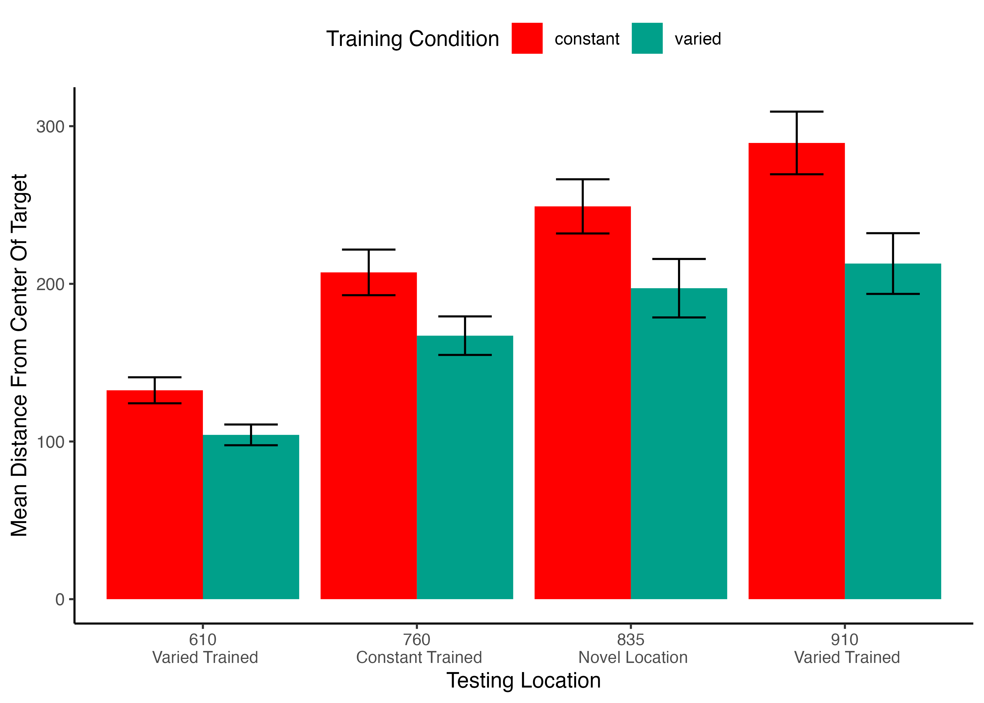
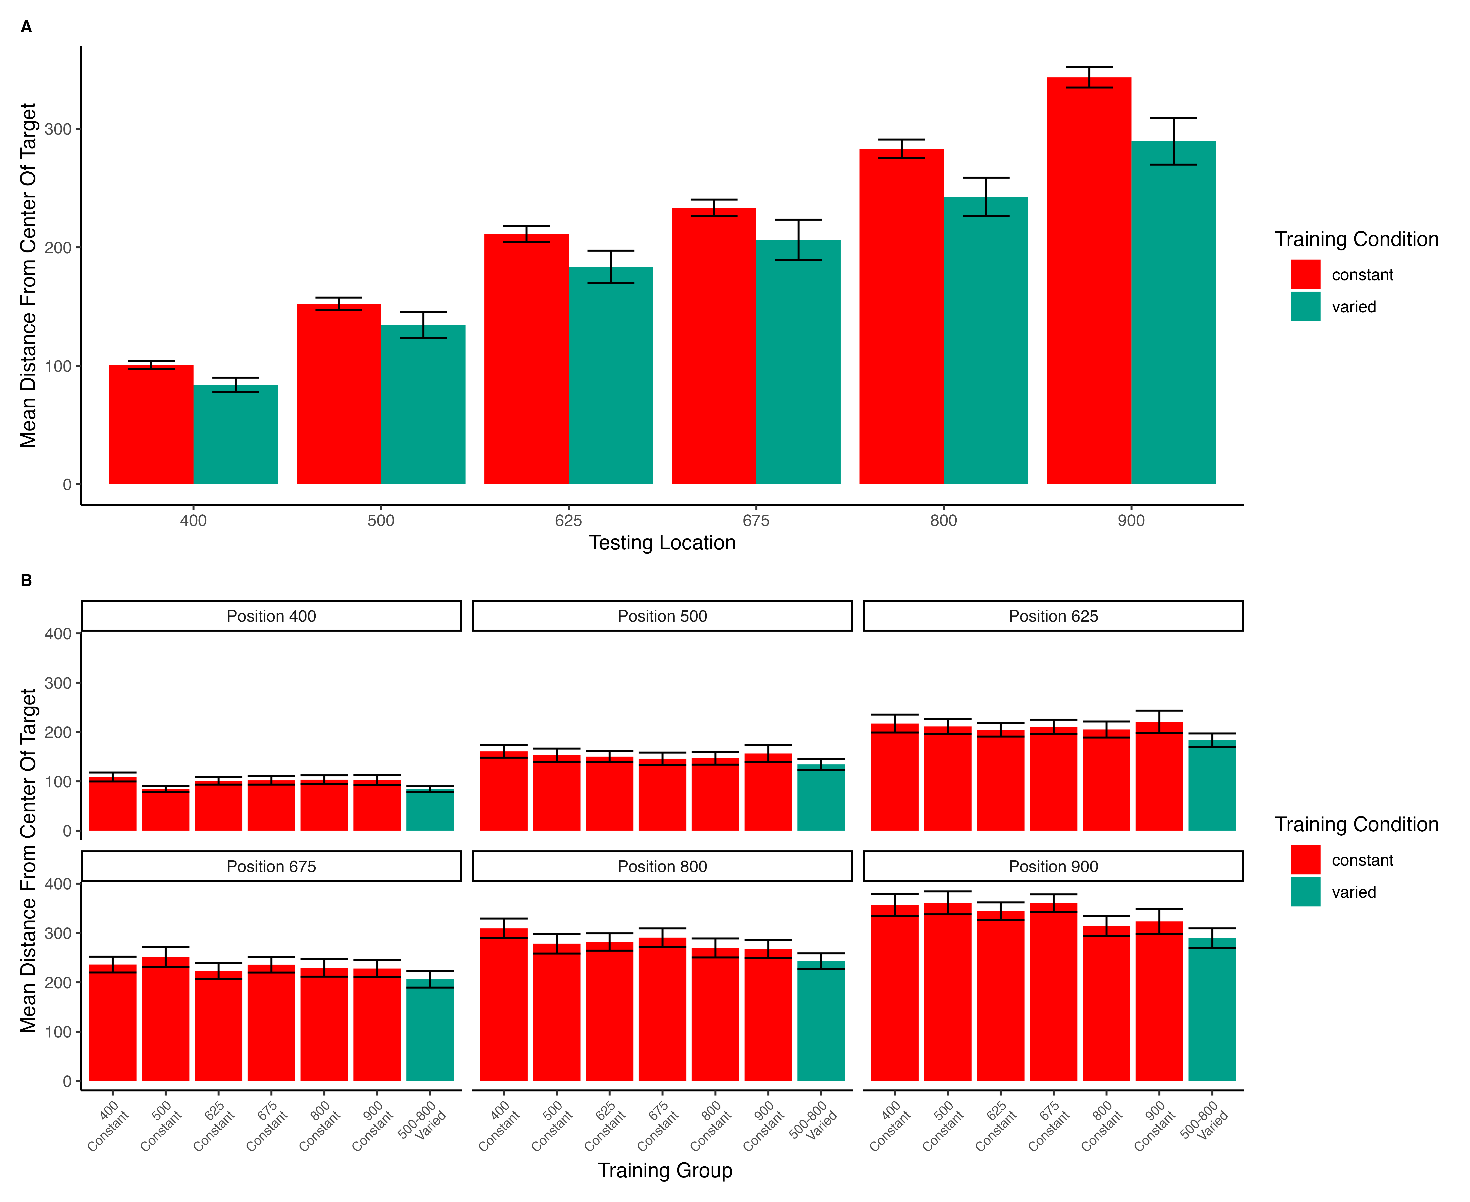
Experiment 1
Experiment 2

Slide 15
Project 1 - Discussion
Varied training group’s superior performance
Computational modeling results with IGAS
Theoretical implications

Slide 16
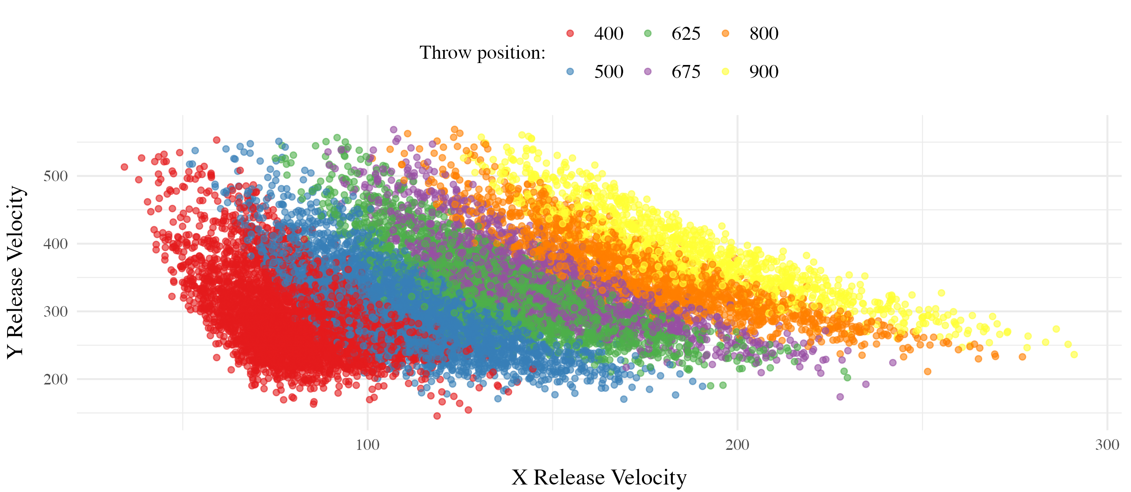
Project 1 Computational Model
Model of Similarity between training and solutions

Slide 17
Model of Similarity between training and solutions

Slide 18
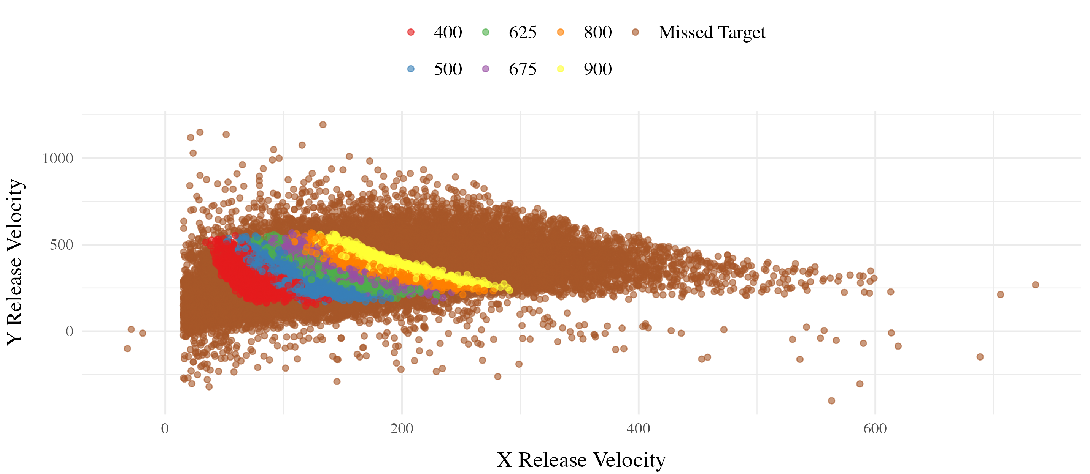
some text

Slide 19
Project 1 Computational Model
For each subject, compute similarity between training throws and each of the 6 testing locations
Test whether similarity explains the difference in performance between Constant and Varied conditions
Assuming equivalent generalization (1 c for both groups) - similarity improves model fit, but does not explain group difference
Assume training condition influences generalization gradient (fit c separately) - now similarity does explain the difference between Constant and Varied.
Equation 1:
SimilarityI,J=i=I​j=J​e−c⋅di,jp
Equation 2:
$$d_{i,j}=\sqrt{{\left(x_{Train_{i}}−x_{Solution_{j}}\right)}^{2}+{\left(y_{Train_{i}}−y_{Solution_{j}}\right)}^{2}}$$
Project 1 General Discussion

Slide 20
Project 2 - Variability and Extrapolation in a Function Learning Task
Influence of varied practice in a function learning task
Experiments 1, 2, and 3:
Training regimes and testing conditions
Learning, discrimination, and extrapolation performance metrics

Slide 21
Project 2 - Questions and Goals
Empirical - Design a task-space large enough to assess multiple degrees of extrapolation - Compare varied and constant generalization from several distinct distances from their nearest training condition
Model-based - If variation does influence extrapolation, can a connectionist model with similarity-based activation provide a good account? - Can our modelling framework simultaneously account for both training and testing data? - Accounting for the full distribution of responses

Slide 22
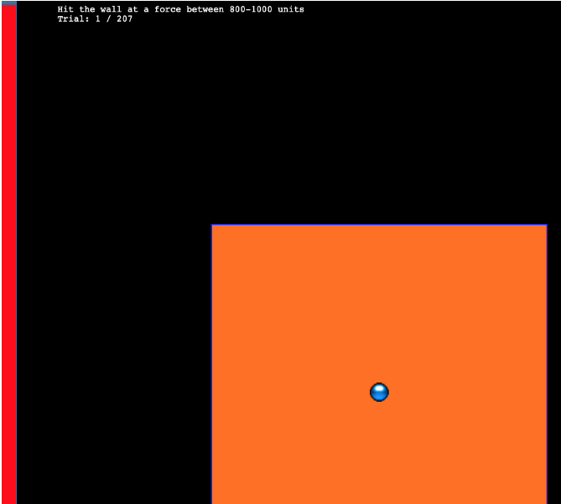
Hit The Wall Task
A total of 156 participants from IU’s online subject pool
Varied group trains from 3 “velocity bands”, constant group from 1

Slide 23
Project 2 - Methodology
A total of 156 participants from IU’s online subject pool
Varied group trains from 3 “velocity bands”, constant group from 1

Slide 24
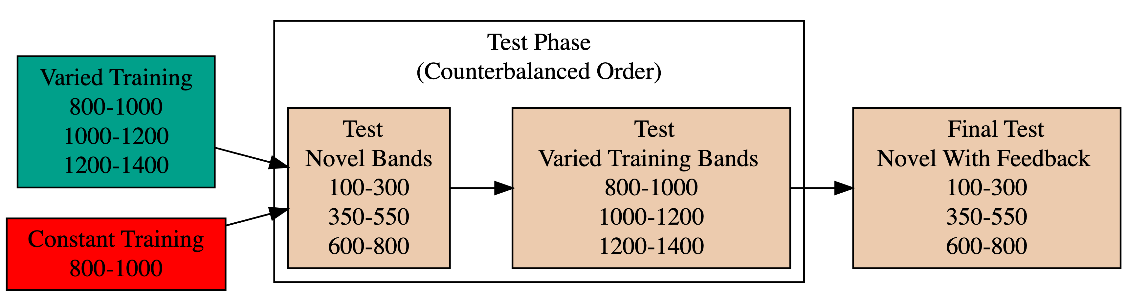
Project 2 - Methodology

Slide 25
Experiment 1 Design. Constant and Varied participants complete different training conditions.

Slide 26
Project 2 - Experiment 1 Results

Slide 27
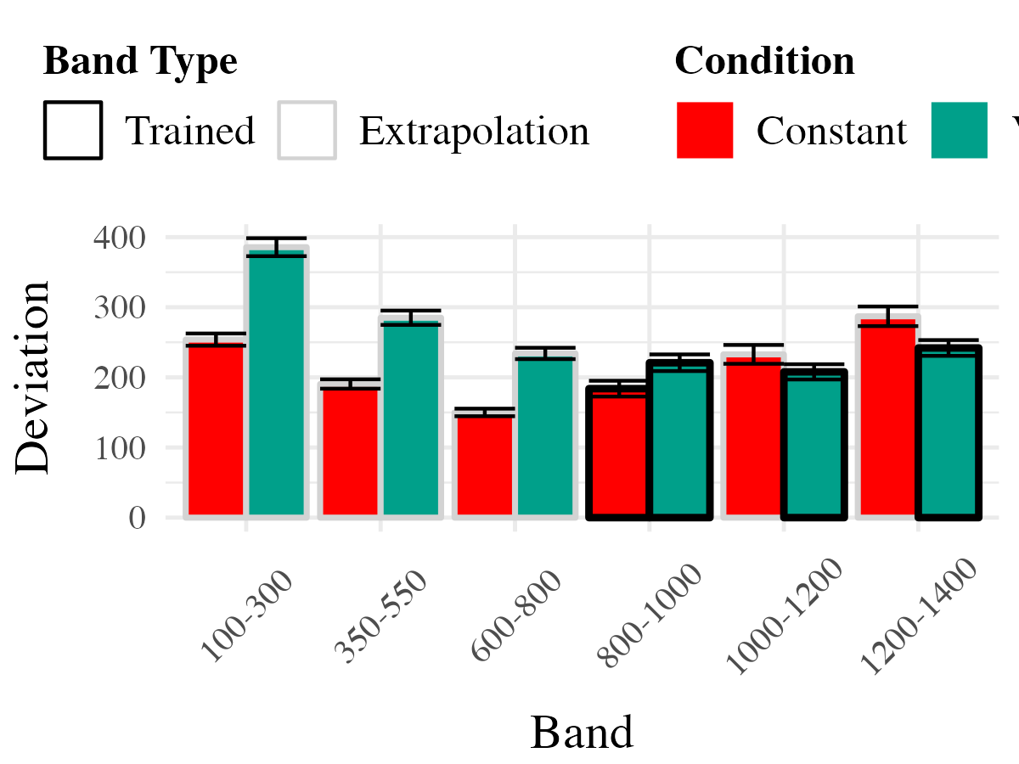
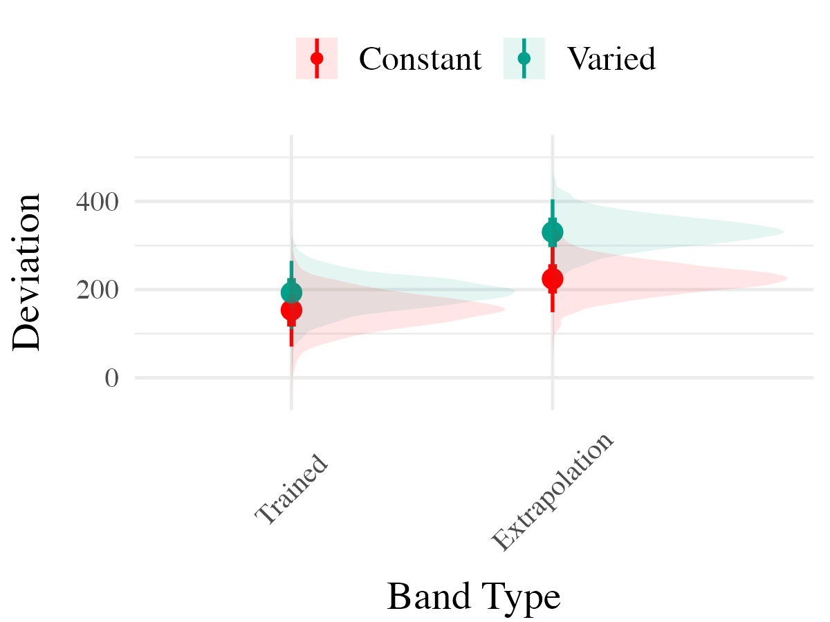
Plot 1
Plot 2

Slide 28
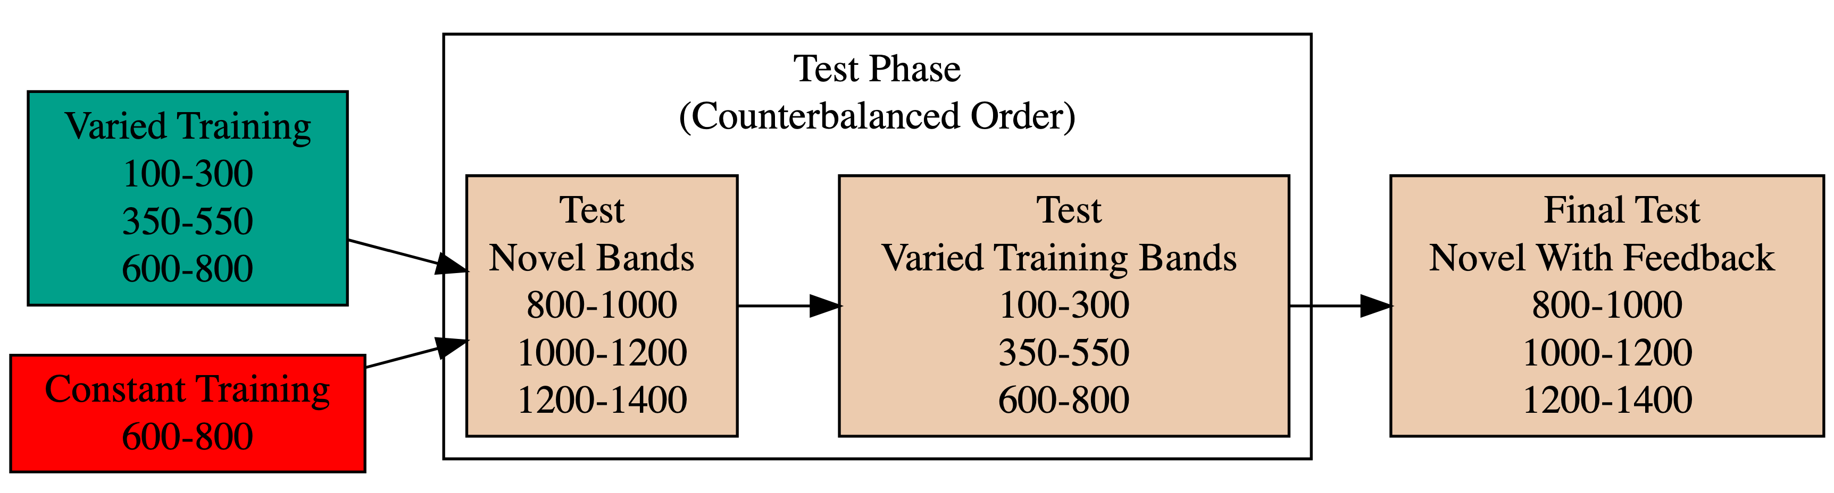
Project 2 - Experiment 2 Design

Slide 29
Experiment 2 Design. Constant and Varied participants complete different training conditions. The training and testing bands are the reverse of Experiment 1.
Project 2 - Experiment 2 Results

Slide 30
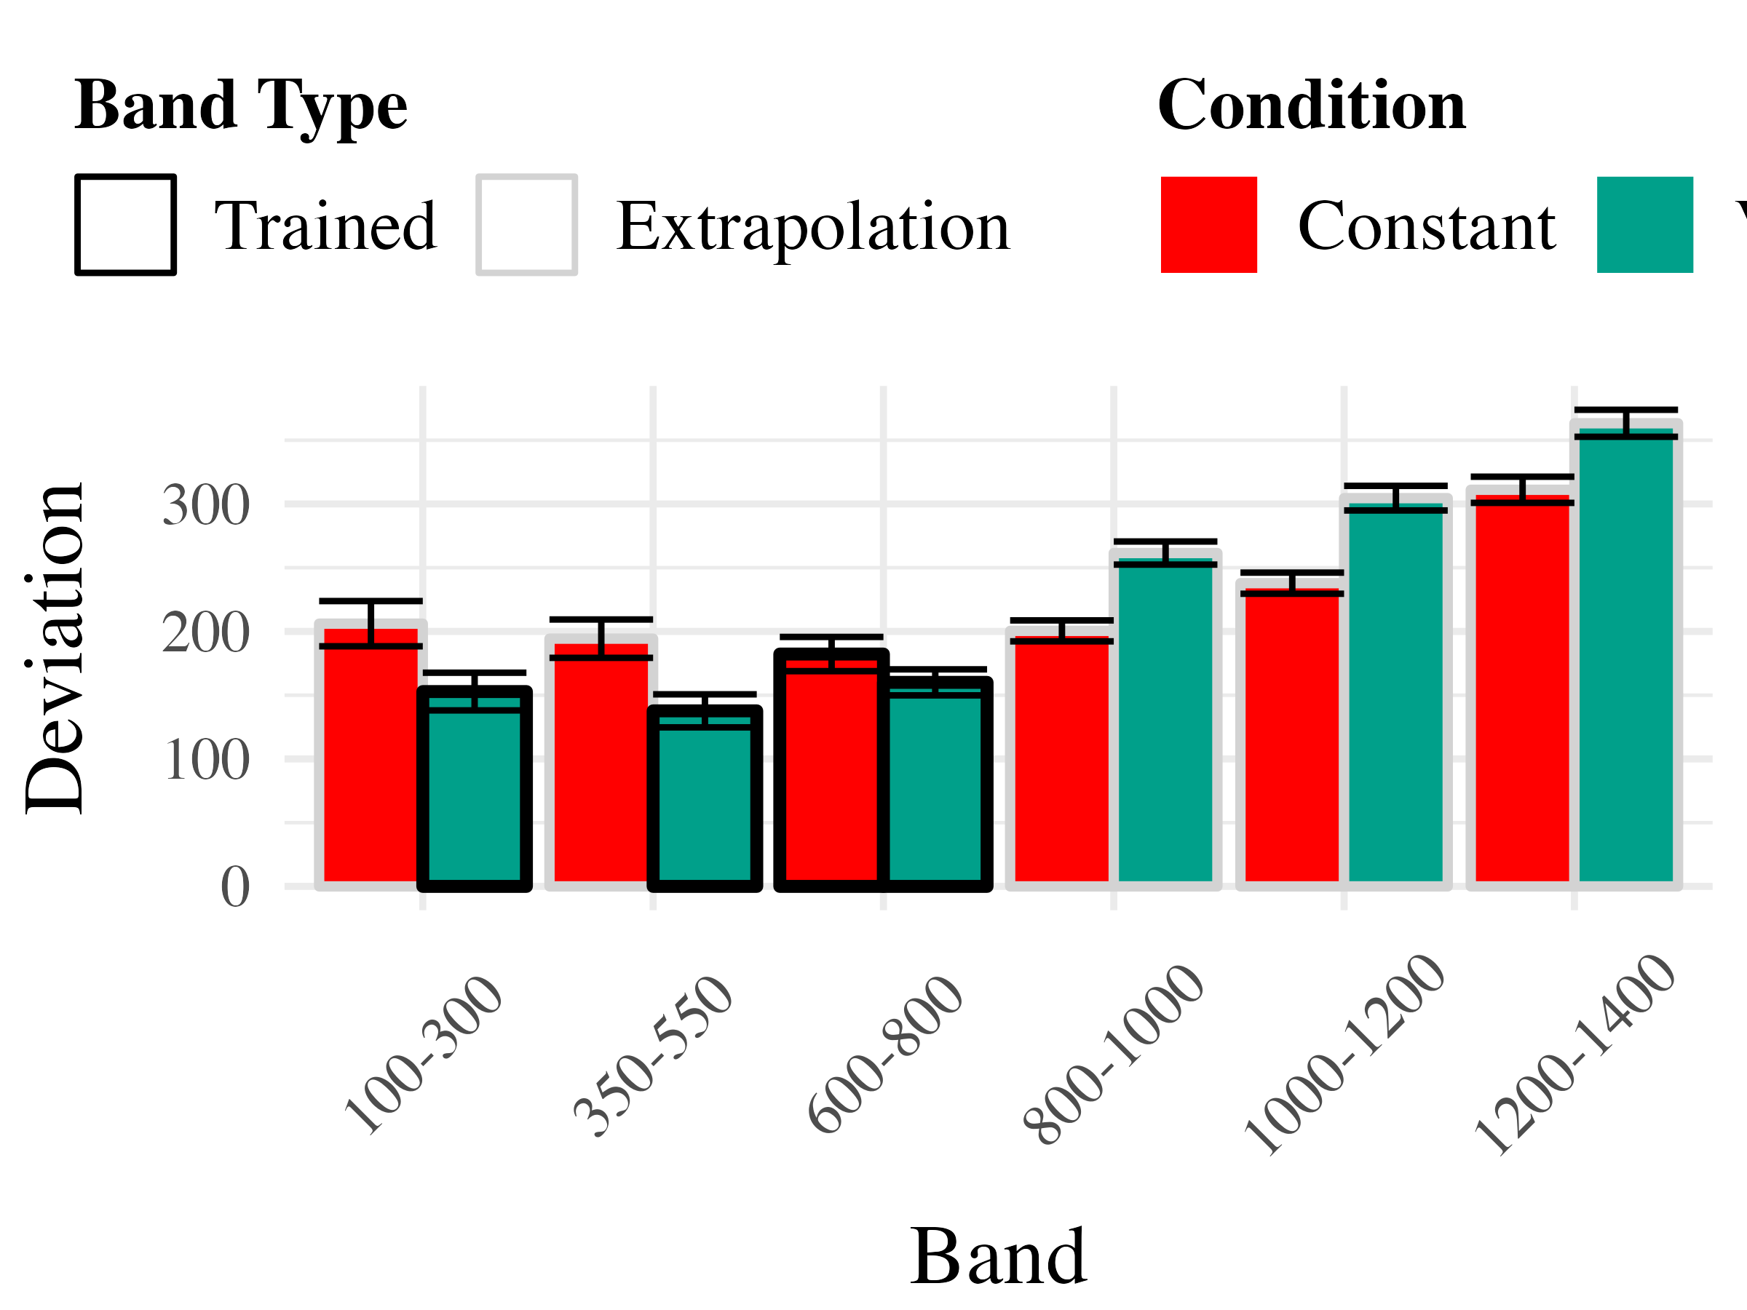
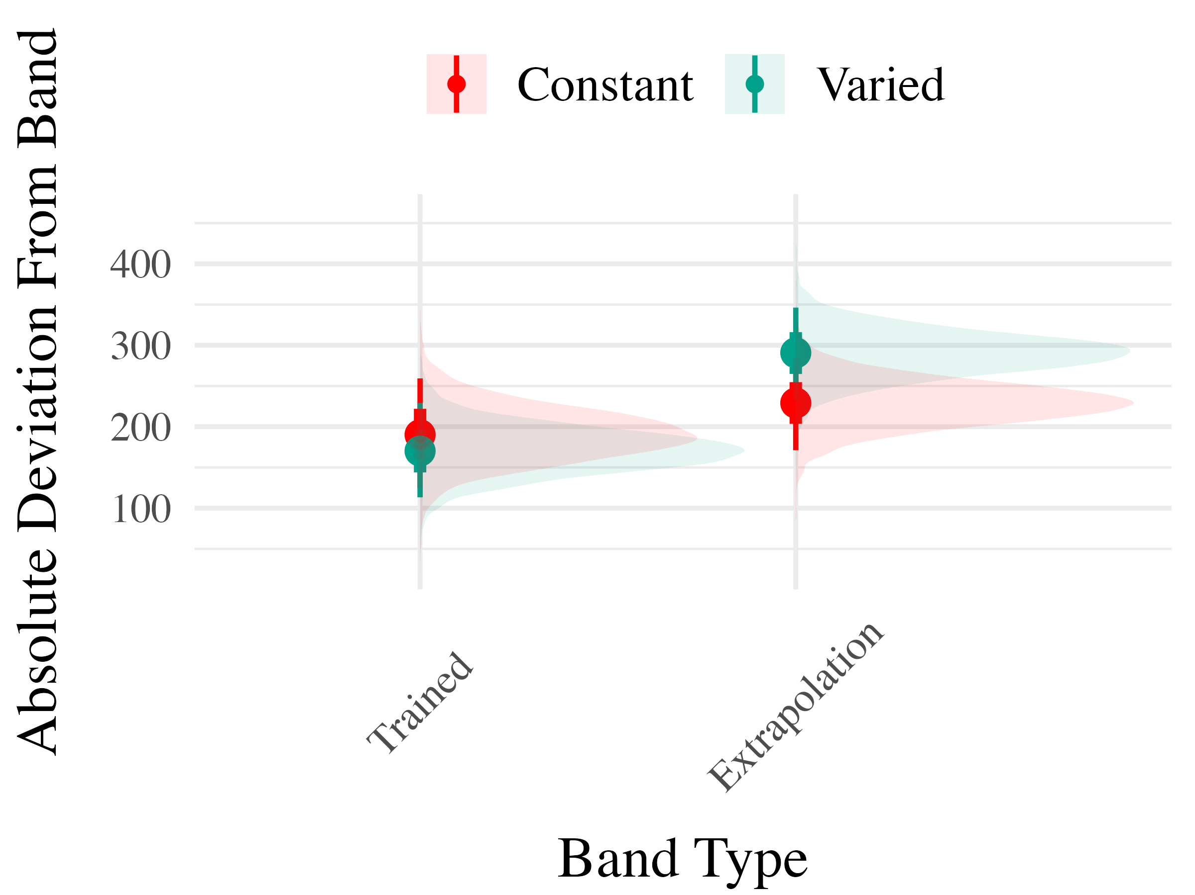
Plot 1
Plot 2

Slide 31
Project 2 - Experiment 3
Ordinal Feedback
Both Reverse and Original Feedback Order
Project 2 - Experiment 3 Results
Accuracy

Slide 32
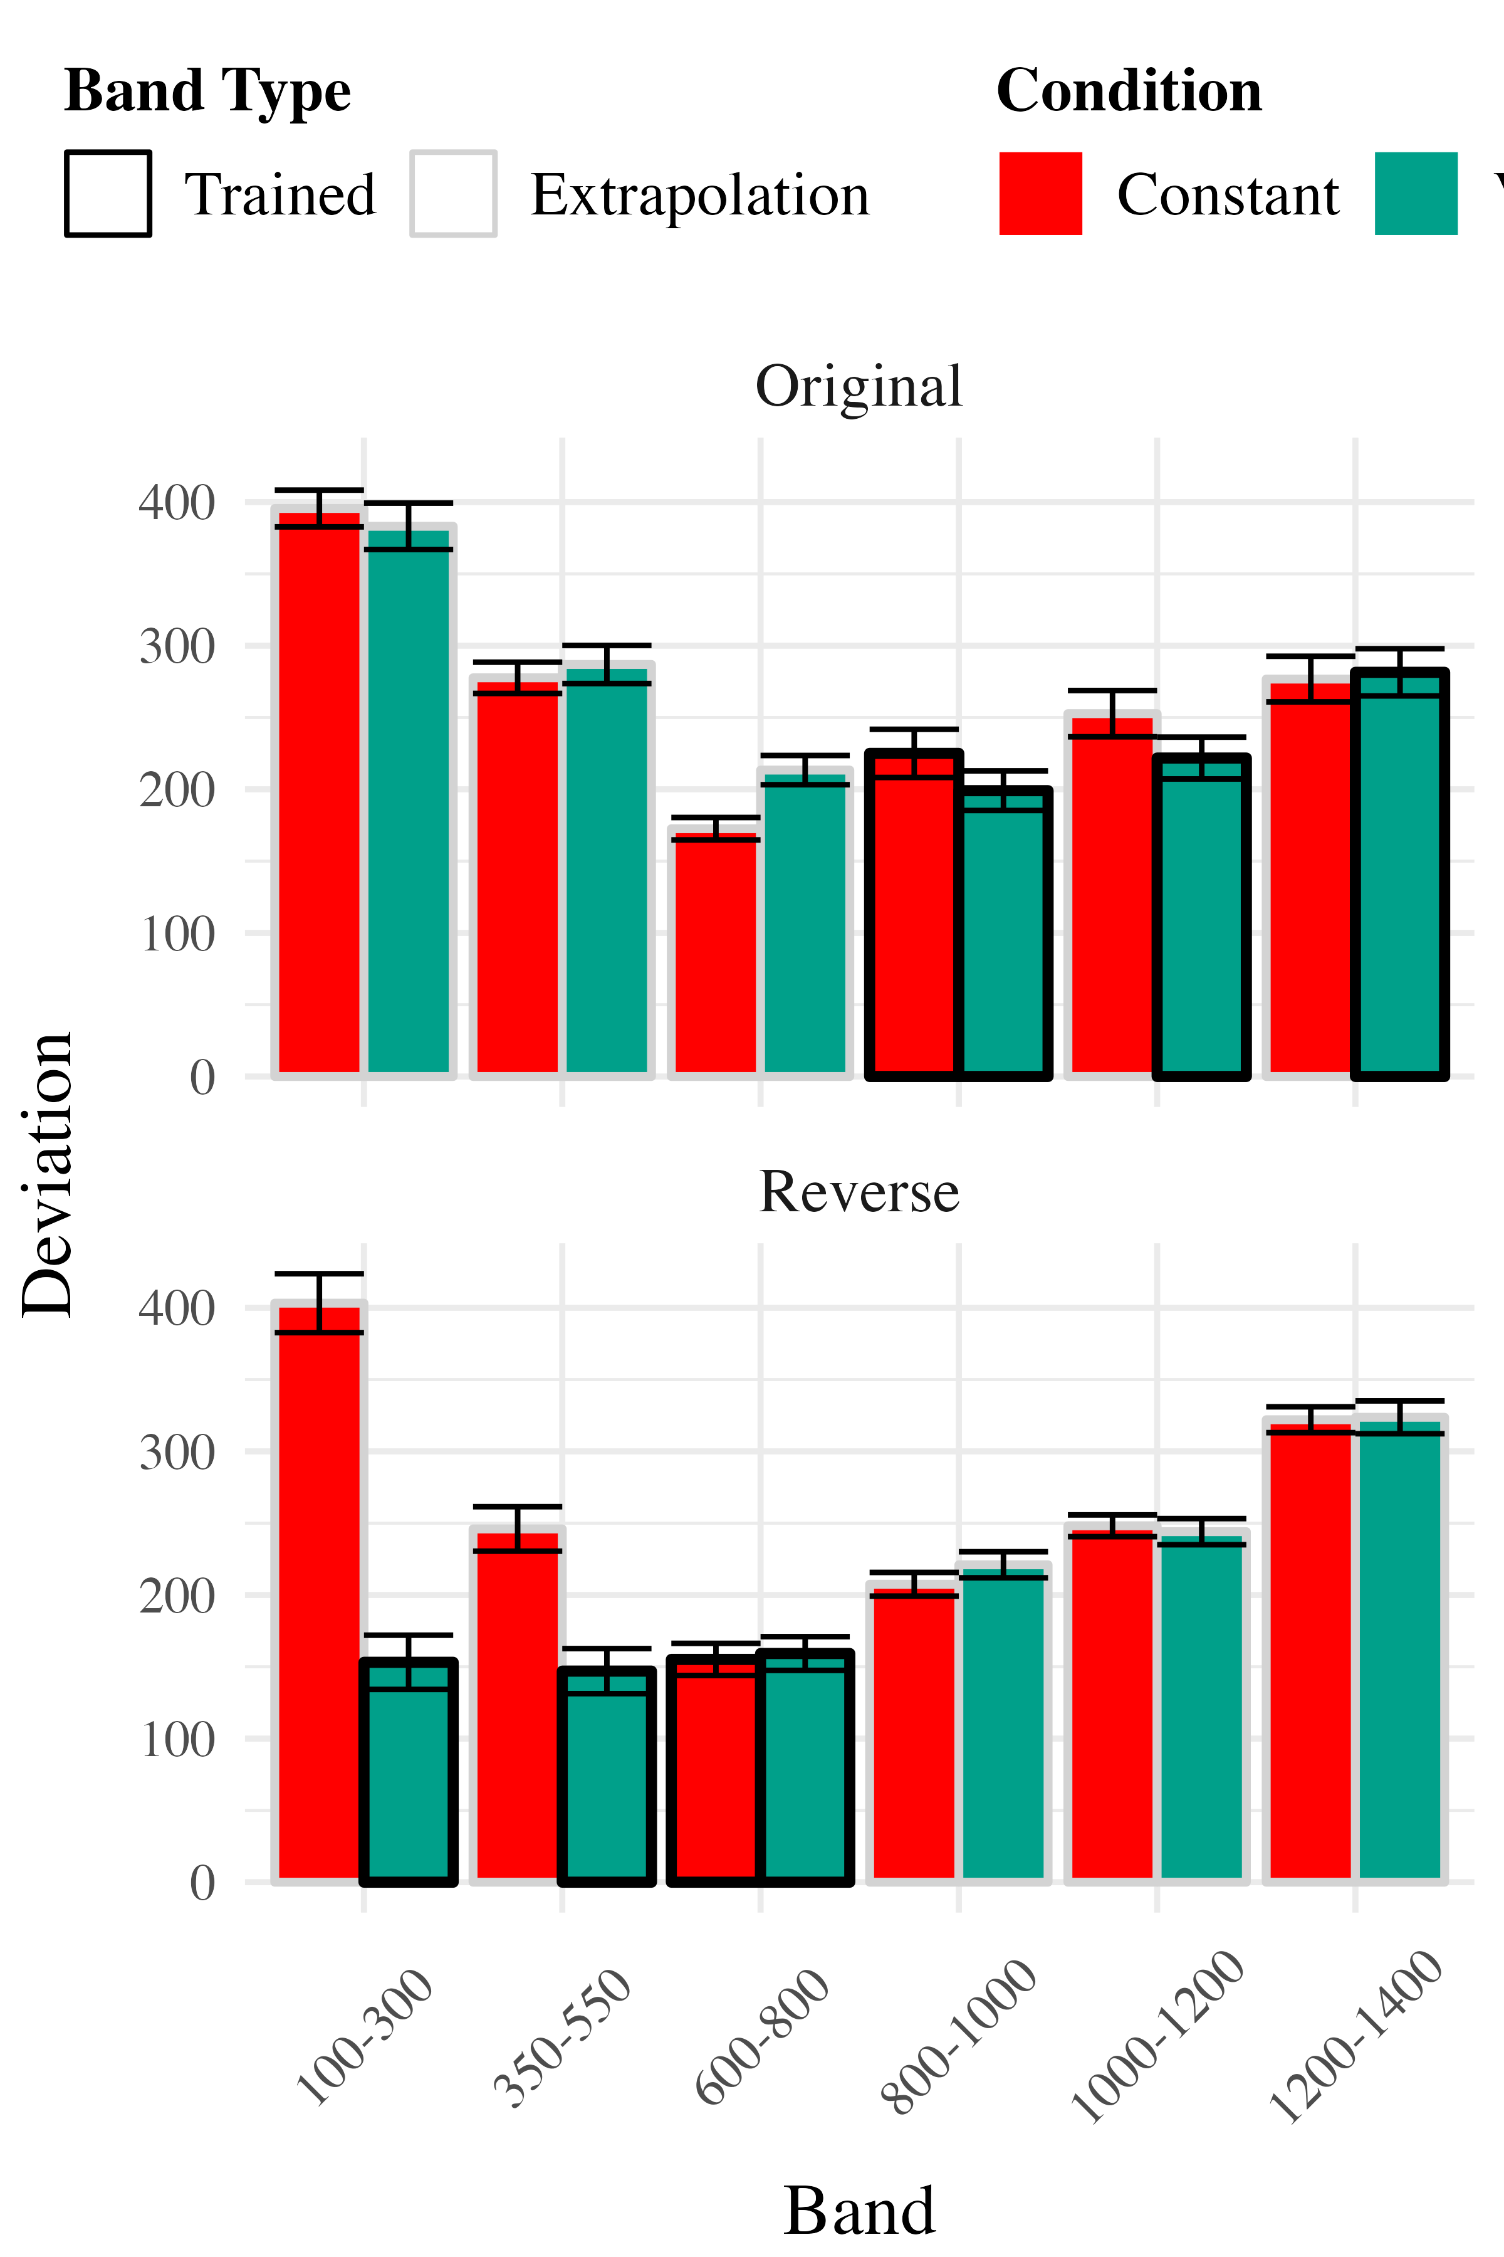
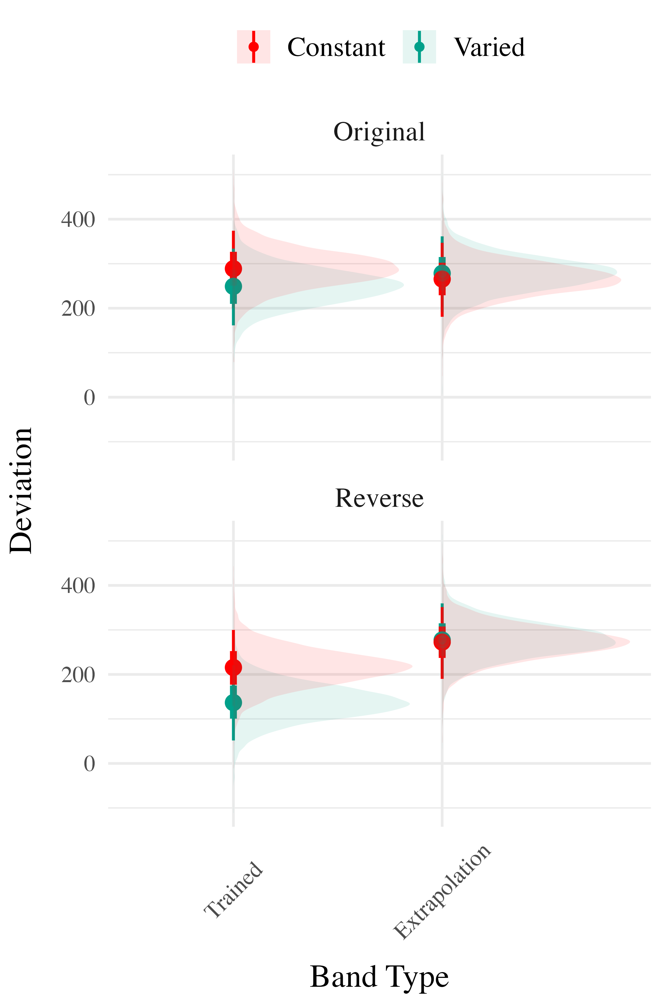
Plot 1
Plot 3

Slide 33
Discrimination

Slide 34
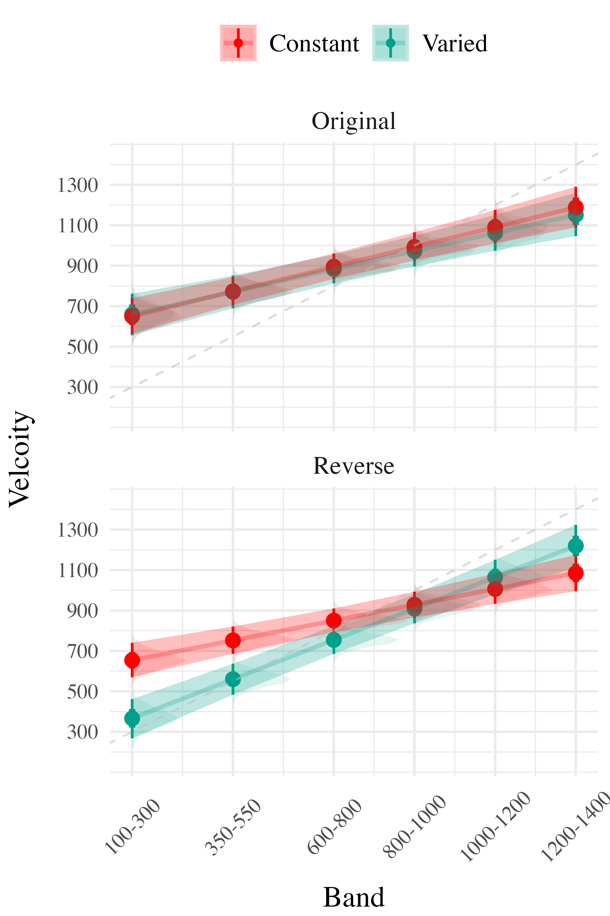
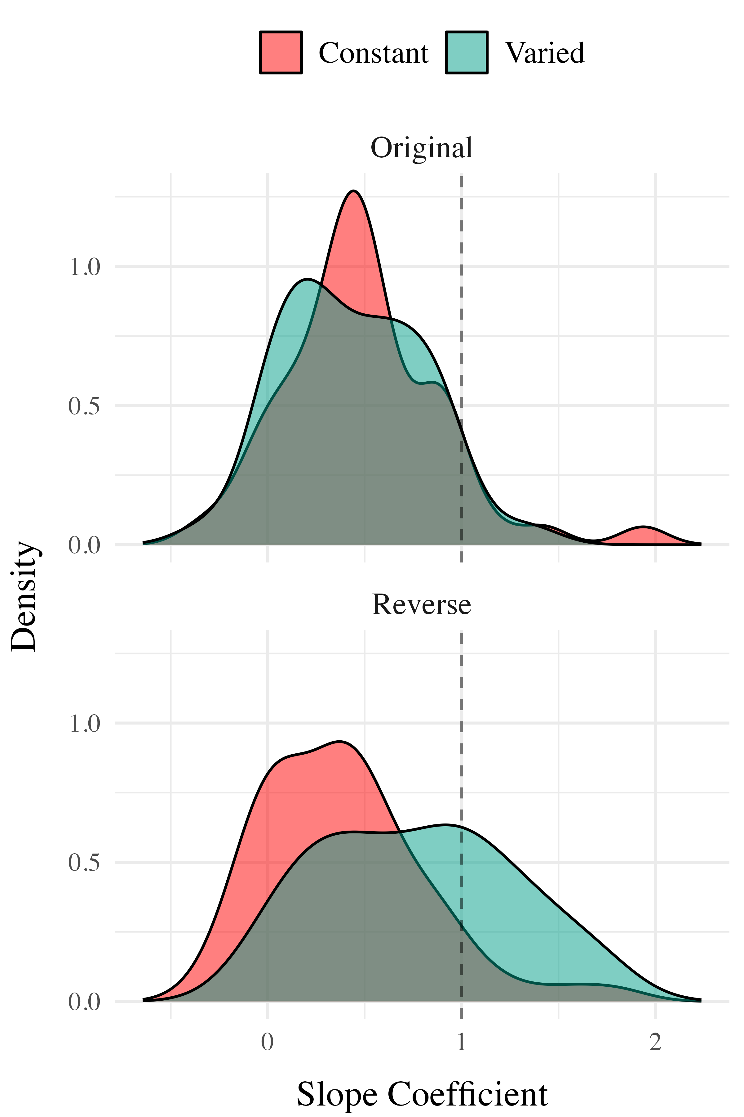
Plot 1
Plot 3

Slide 35
Project 2 - Computational Modeling
Project 2 - ALM

Slide 36
Plot 1
Plot 3

Slide 37
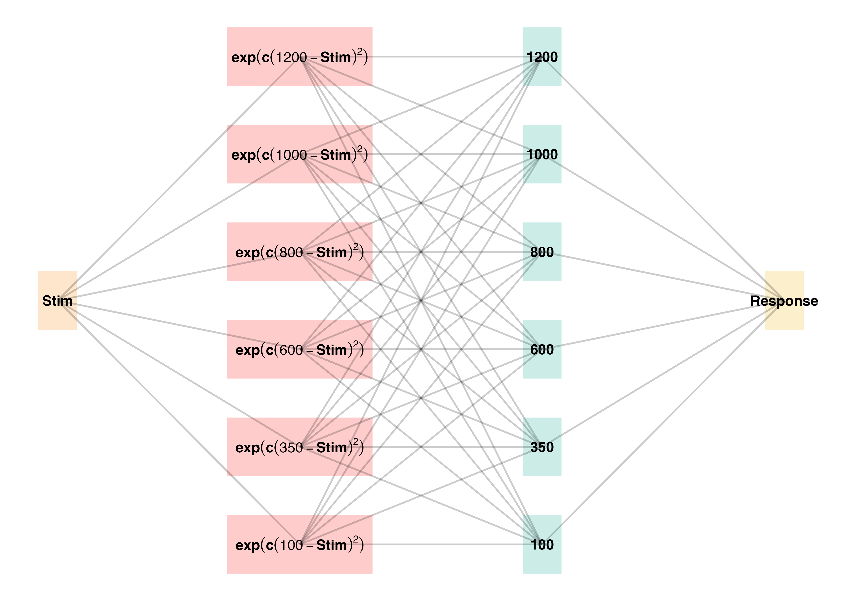

Slide 38
 | ALM Response Generation
Input Activation | $a_{i}\left(X\right)=\frac{e^{−c{\left(X−X_{i}\right)}^{2}}}{\sum_{k=1}^{M}{e^{−c{\left(X−X_{k}\right)}^{2}}}}$ | Input nodes activate as a function of Gaussian similarity to stimulus
Output Activation | $O_{j}\left(X\right)=\sum_{k=1}^{M}{w_{ji}}⋅a_{i}\left(X\right)$ | Output unit $O_{j}$ activation is the weighted sum of input activations and association weights
Output Probability | $P\left[Y_{j}|X\right]=\frac{O_{j}\left(X\right)}{\sum_{k=1}^{M}{O_{k}}\left(X\right)}$ | The response, $Y_{j}$ probabilites computed via Luce’s choice rule
Mean Output | $m\left(X\right)=\sum_{j=1}^{L}{Y_{j}}⋅\frac{O_{j}\left(x\right)}{\sum_{k=1}^{M}{O_{k}}\left(X\right)}$ | Weighted average of probabilities determines response to X
 | ALM Learning
Feedback | $f_{j}\left(Z\right)=e^{−c{\left(Z−Y_{j}\right)}^{2}}$ | feedback signal Z computed as similarity between ideal response and observed response
magnitude of error | $Δ_{ji}=\left(f_{j}\left(Z\right)−o_{j}\left(X\right)\right)a_{i}\left(X\right)$ | Delta rule to update weights.
Update Weights | $w_{ji}^{new}=w_{ji}+ηΔ_{ji}$ | Updates scaled by learning rate parameter $η$.
ALM

Slide 39
 | EXAM Response Generation
Instance Retrieval | $P\left[X_{i}|X\right]=\frac{a_{i}\left(X\right)}{\sum_{k=1}^{M}{a_{k}}\left(X\right)}$ | Novel test stimulus $X$ activates input nodes $X_{i}$
Slope Computation | $S=\frac{m\left(X_{1}\right)−m\left(X_{2}\right)}{X_{1}−X_{2}}$ | Slope value, $S$ computed from nearest training instances
Response | $E\left[Y|X_{i}\right]=m\left(X_{i}\right)+S⋅\left[X−X_{i}\right]$ | Final EXAM response is the ALM response for the nearest training stimulus, $m\left(X_{i}\right)$, adjusted by local slope $S$.
EXAM

Slide 40
Project 2 - Model Fitting Procedure
Approximate Bayesian Computation

Slide 41
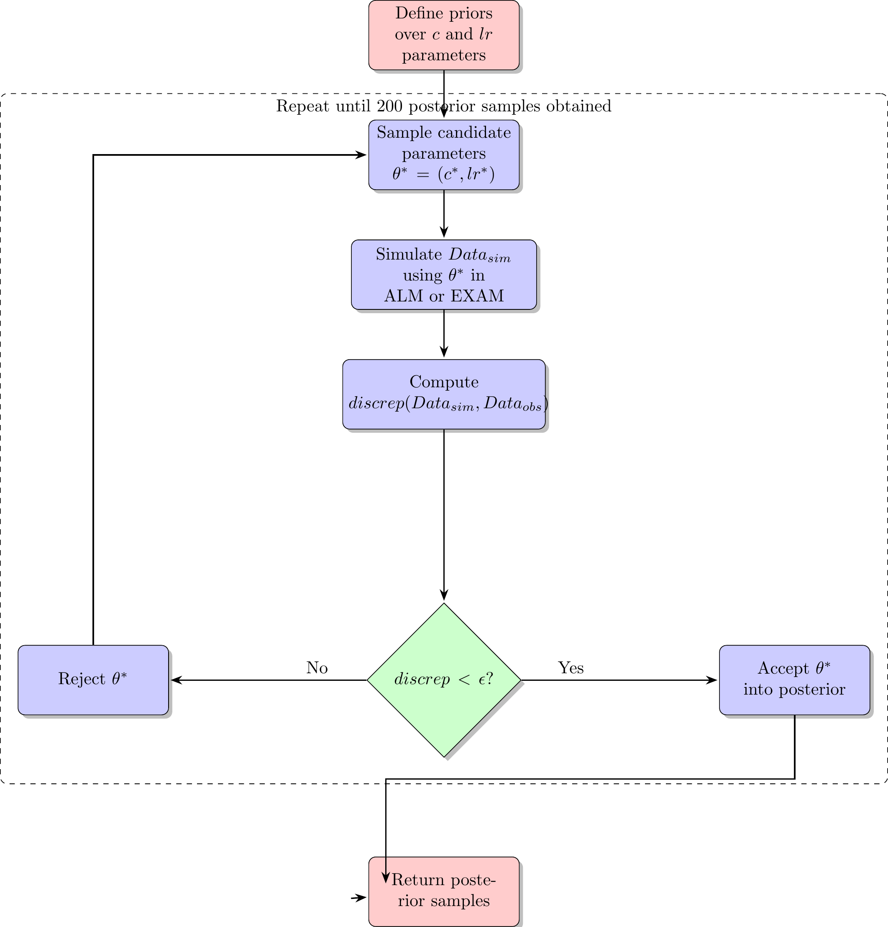
simulation based approach
approximate likelihood
uncertainty in parameter values
full distribution of plausible model predictions for each participant

Slide 42
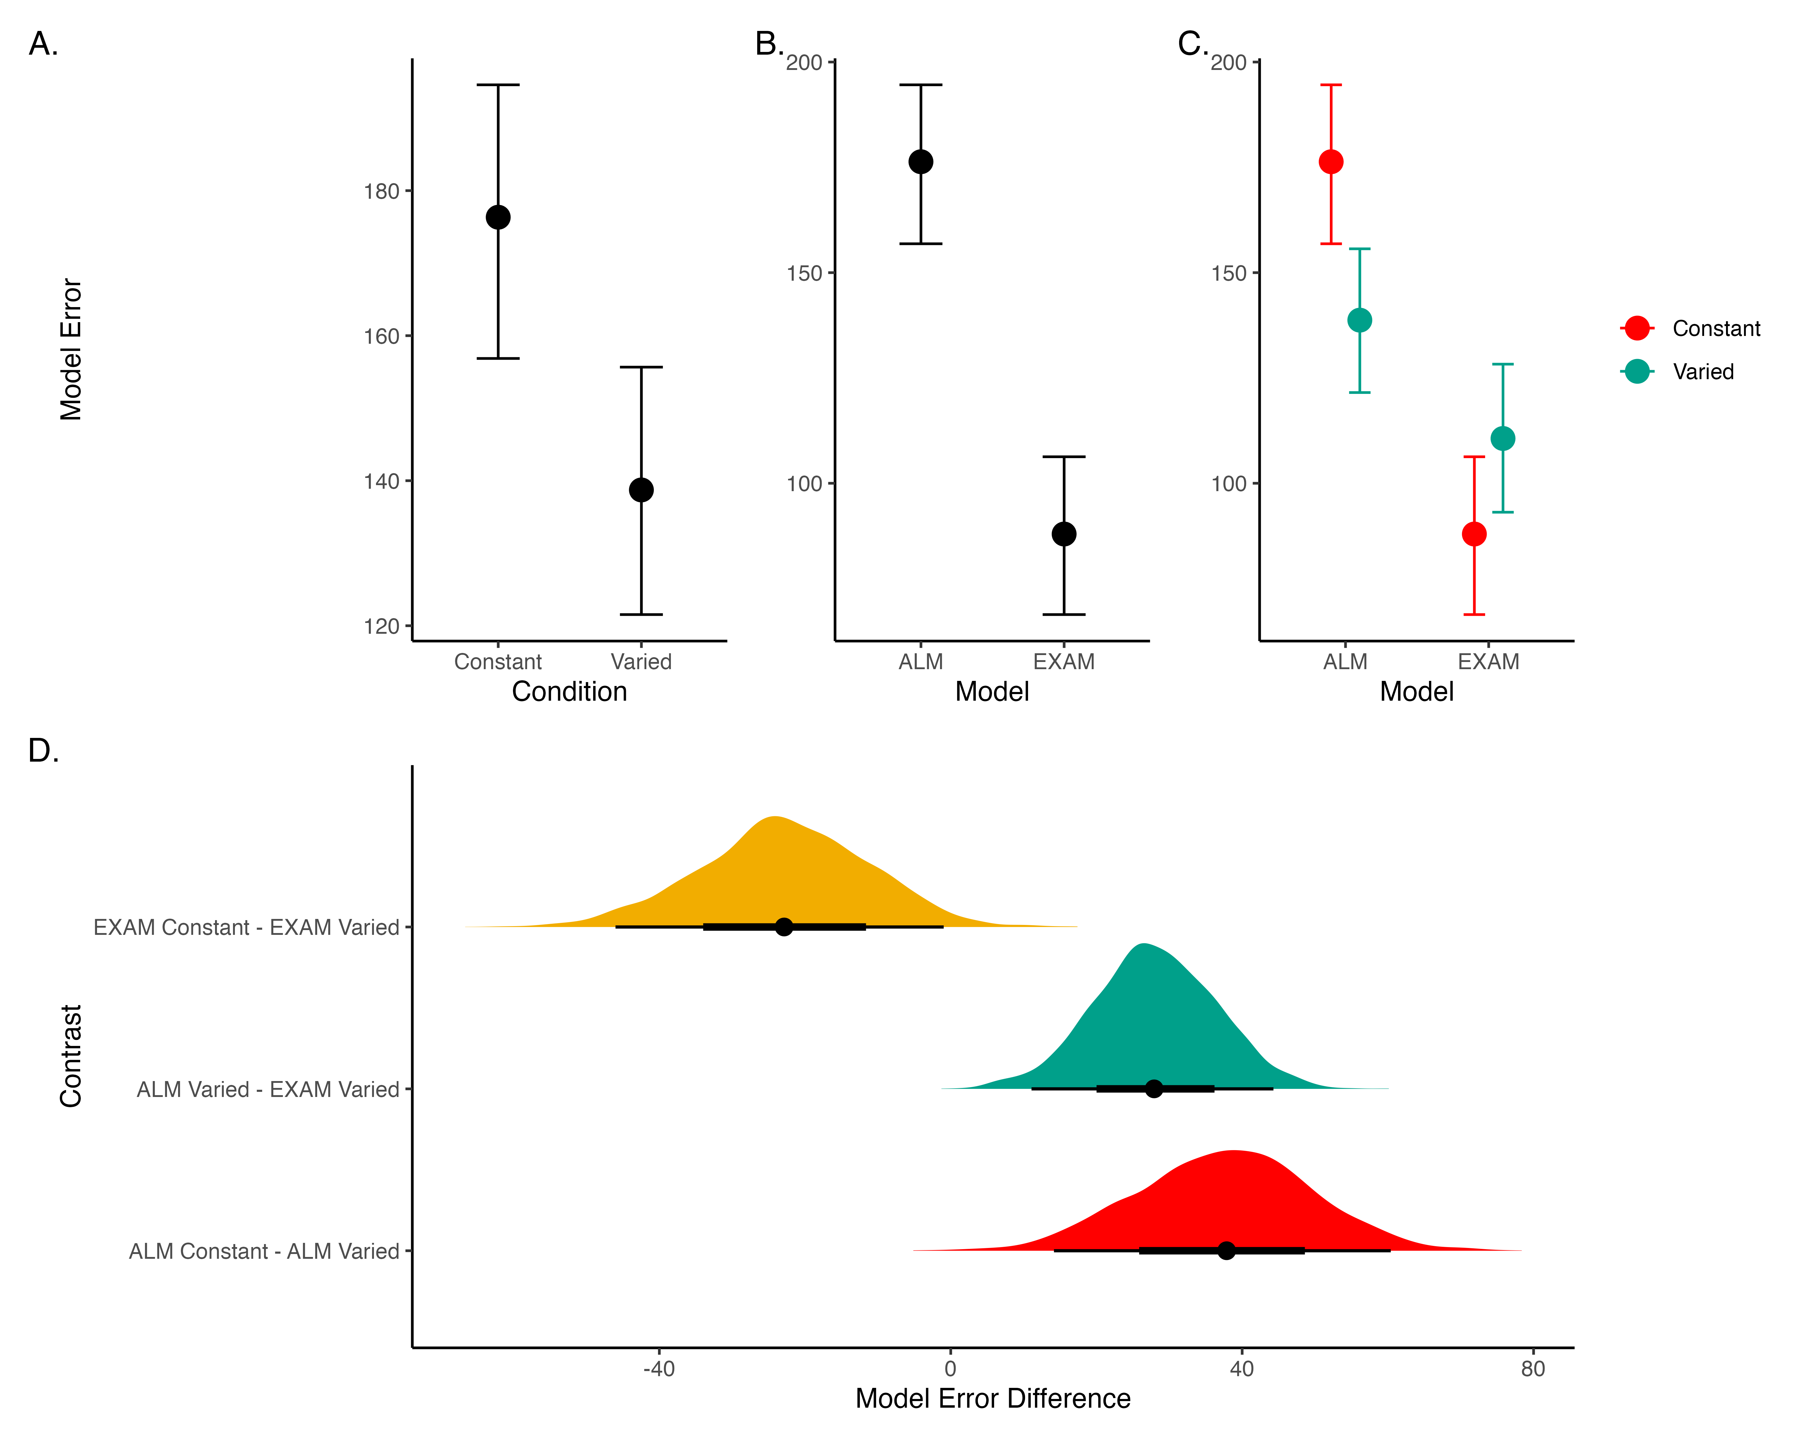
Modelling Results

Slide 43
General Discussion
Compare HTT and HTW
Empirical findings summary
Computational modeling contributions

Slide 44
Dimension | HTT (Project 1) | HTW (Project 2)
Task Description | Projectile launching to hit a target | Projectile launching to hit wall at a specific velocity
Task Complexity | More complex parabolic trajectory, both x and y velocities relevant to outcome | Simpler 1D mapping of force to outcome. Only x velocity is relevant.
Task Space | More complex: xy velocity combinations closer to the solution space may still result in worse feedback due to striking the barrier. | Simpler: smooth, linear mapping between velocity and feedback.
Perceptual salience of Varied Conditions | Varied conditions (# of throwing distances) are perceptually distinct, i.e. salient differences in distance between launching box and target. | Varied conditions (# of velocity bands) are less salient - only difference is the numeral displayed on screen.
Testing Feedback | Testing always included feedback | Primary testing stage had no feedback.
Potential for Learning during Testing | Limited potential for learning during testing due to feedback. | Some potential for learning during no-feedback testing by observing ball trajectory.
Training Experience | Varied group gets half as much experience on any one position as the constant group. | Varied group gets 1/3 as much experience on any one velocity band as the constant group.
Testing Structure | Random interleaving of trained/transfer testing distances. | Blocked structure, separately testing trained vs extrapolation testing bands.
Comparison

Slide 45
Theoretical Contributions
Insights into training variability effects on learning and generalization
Computational models applications

Slide 46
Practical Implications
Training programs design implications
Future research considerations

Slide 47
Limitations and Future Directions
Study limitations
Future research suggestions

Slide 48
Conclusion
Recap of key findings
Final thoughts on training variability’s role in learning

Slide 49
Questions and Discussion
Open floor for questions from the committee and audience
Future Research Directions

Slide 50
Theoretical Extensions
Investigate the role of individual differences in training variability effects.
Explore the impact of different types of feedback on learning and generalization.
Examine the influence of task complexity on the benefits of varied training.
Methodological Innovations
Develop new experimental paradigms to test training variability in more complex tasks.
Utilize advanced computational models to simulate learning processes under varied conditions.
Implement longitudinal studies to assess long-term effects of training variability.
Practical Applications
Design adaptive training programs that adjust variability based on learner performance.
Apply findings to educational settings to enhance learning outcomes.
Use insights to improve training protocols in professional skill development.
Collaborative Opportunities
Partner with educational institutions to test training variability in classroom settings.
Collaborate with industry professionals to apply research findings in real-world training programs.
Engage with interdisciplinary teams to explore the broader implications of training variability.

